Slide 1

Selenium
Book Report
February 19, 2024

Slide 2
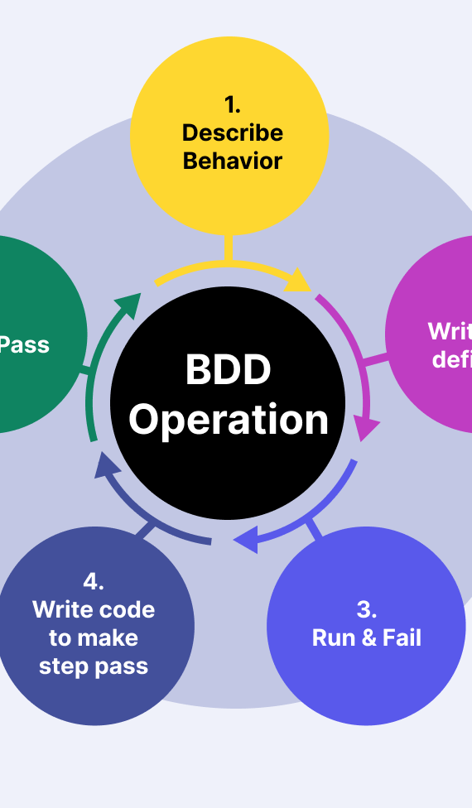
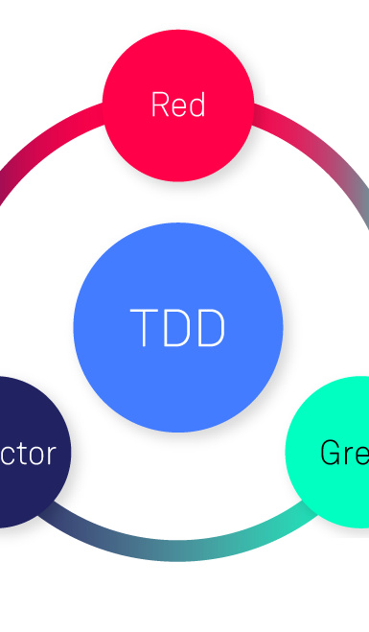

What is Selenium ?
Testing Framework
Key Features
Selenium Components
WebDriver
Selenium IDE
Notes:
Item one: Introduction to Selenium
"Selenium is a powerful open-source testing framework used to conduct web browser automation. It allows you to write scripts in various programming languages like Java, Python, C#, etc.“`
"It's used by developers and testers to ensure that web applications function correctly across different web browsers and platforms."
Item two: Key Features
"One of the key features of Selenium is its ability to integrate with other software to enhance its functionality, such as TestNG for testing frameworks and Jenkins for Continuous Integration/Continuous Deployment pipelines."
"It supports parallel test execution, which reduces the time for test execution when dealing with a large number of test cases."
Item three: Selenium Components
Sub-item one: Selenium IDE
"Selenium consists of several components, each serving a unique purpose. Selenium WebDriver directly controls a browser and executes the tests."
Sub-item one: Selenium IDE
"Selenium IDE is a browser extension that allows you to record, edit, and debug tests. It's a great tool for beginners to learn about Selenium scripts."

Slide 3



Why use Selenium?
Browser Compatibility
Language Support
Open Source and Community
Flexibility
Integration
Advanced Capabilities
Notes:
Item one: Browser Compatibility
"Selenium ensures that a web application works seamlessly across various web browsers. It can simulate actions in browsers like Chrome, Firefox, Safari, and others."
"This cross-browser testing capability is crucial because it verifies that your web application provides a consistent user experience, no matter where it's accessed from."
Item two: Language Support
"Selenium supports multiple programming languages, including Java, C#, Python, Ruby, and JavaScript. This allows teams to write tests in the language they’re most comfortable with."
"The flexibility in language support means that Selenium easily integrates into different developers' workflows and CI/CD pipelines."
Item three: Open Source and Community
"Being an open-source tool, Selenium is free to use, and it benefits from a large community of contributors. The community provides a wealth of plugins and extensions to enhance its capabilities."
"With the support of this community, it's easier to find solutions to problems, keep up with best practices, and continuously improve your testing strategies."
Sub-item one: Flexibility
"Selenium's modular structure allows you to customize your test automation setup. You can combine it with frameworks like TestNG or JUnit for managing test cases and generating reports."
Sub-item two: Integration
"It integrates well with other tools like Maven or Gradle for project management, Jenkins or Bamboo for continuous integration, and tools like Appium for mobile application testing."
Item four: Advanced Capabilities
"Selenium has advanced capabilities for complex testing scenarios, including explicit and implicit waits, which help in managing synchronizations issues in test scripts."
"It can also simulate complex user gestures like mouse movements, drag-and-drop actions, and keyboard events which are essential for replicating real-user interactions."

Slide 4
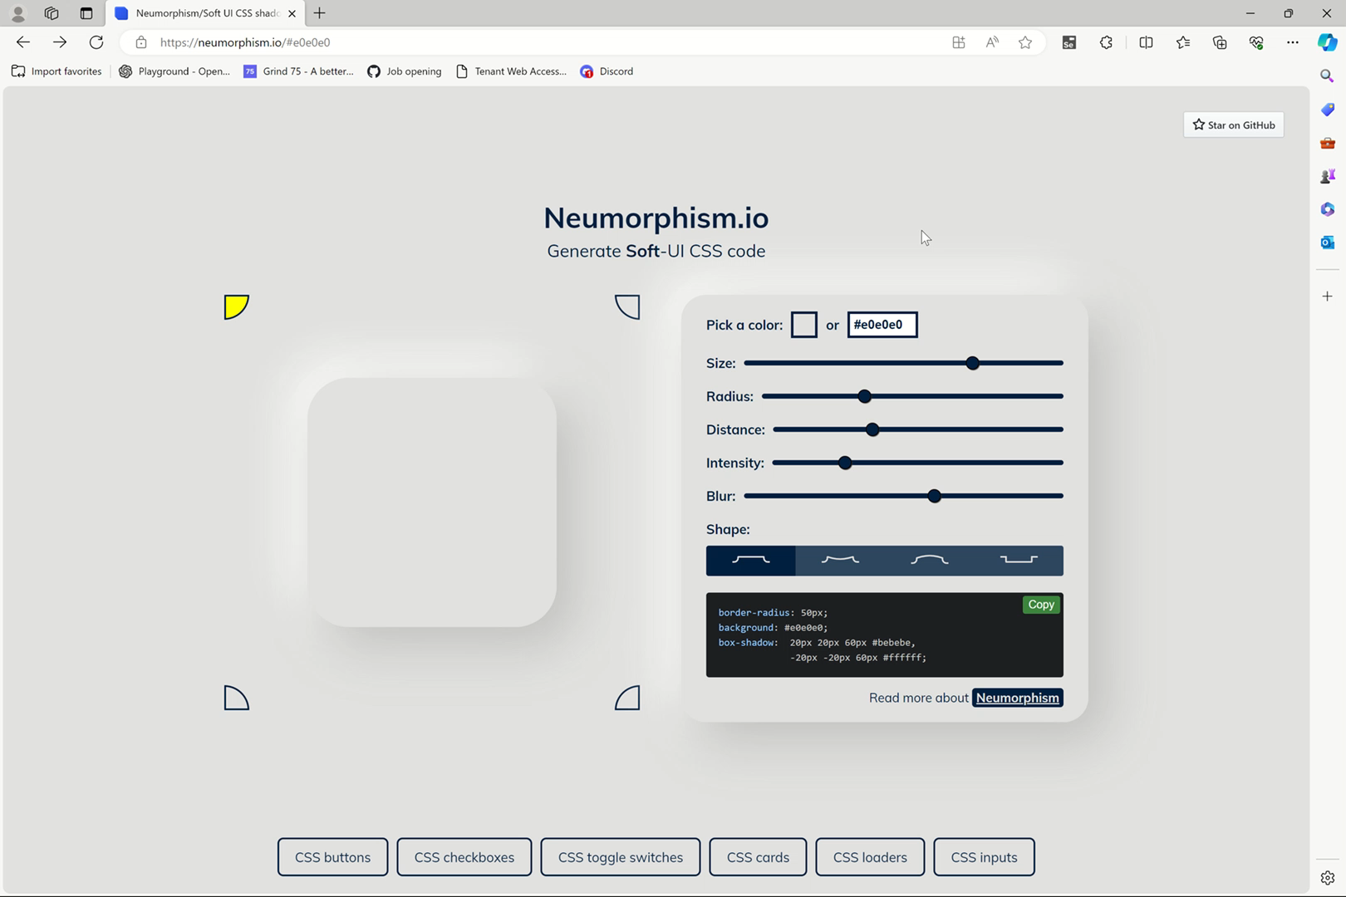
How to use Selenium ?
Selenium IDE
Selenium WebDriver
Install Selenium IDE
Record a Test Case
Edit and Enhance the Test
Add Assertions
Save and Organize Tests
Export Tests
Instantiate a browser driver
Navigate to a Web Page
Locate Web Elements
Perform Actions and Assertions
Wait for Elements
Run across different browsers
Integrate with Test Framework

Slide 5
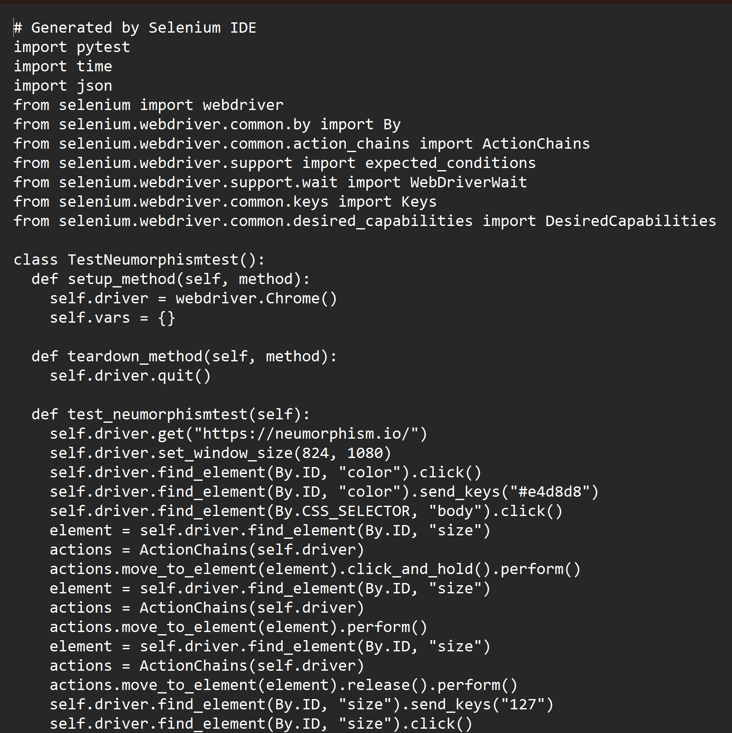
How to use Selenium ?
Selenium IDE
Selenium WebDriver
Install Selenium IDE
Record a Test Case
Edit and Enhance the Test
Add Assertions
Save and Organize Tests
Export Tests
Instantiate a browser driver
Navigate to a Web Page
Locate Web Elements
Perform Actions and Assertions
Wait for Elements
Run across different browsers
Integrate with Test Framework

Slide 6
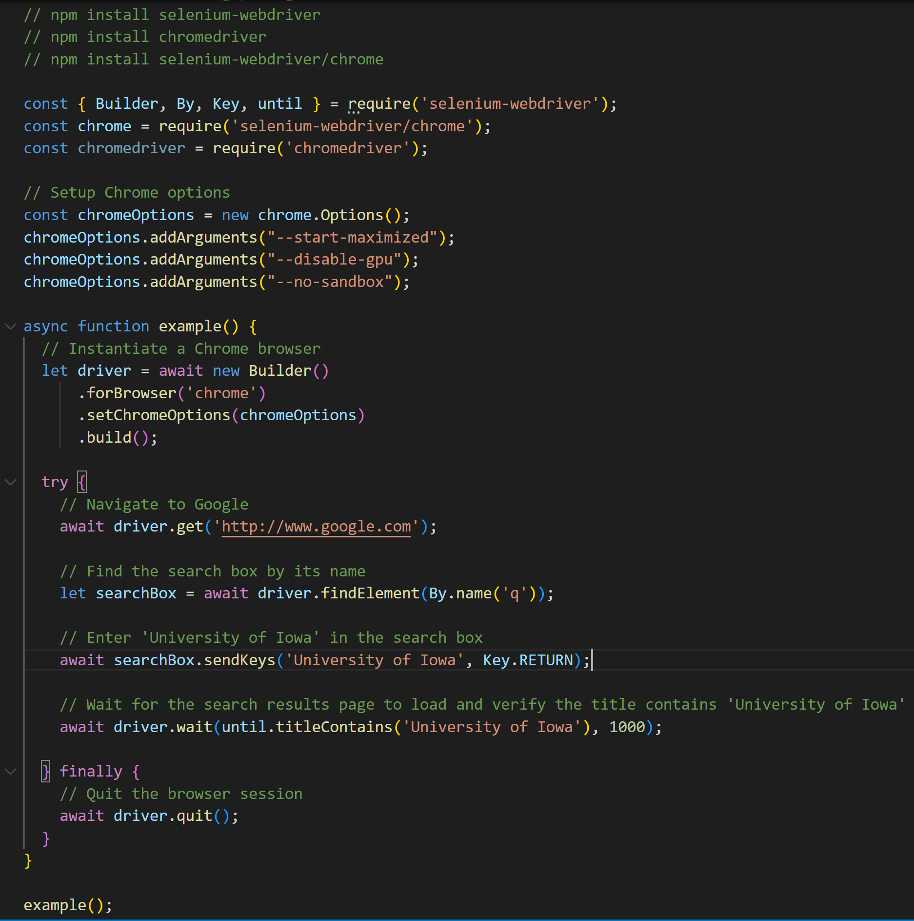
How to use Selenium ?
Selenium IDE
Selenium WebDriver
Install Selenium IDE
Record a Test Case
Edit and Enhance the Test
Add Assertions
Save and Organize Tests
Export Tests
Instantiate a browser driver
Navigate to a Web Page
Locate Web Elements
Perform Actions and Assertions
Wait for Elements
Run across different browsers
Integrate with Test Framework

Slide 7
Questions?
Adnane Ezouhri
Software Engineer
SEP: Team 001_DisAv
https://github.com/SeleniumHQ

